Slide 1
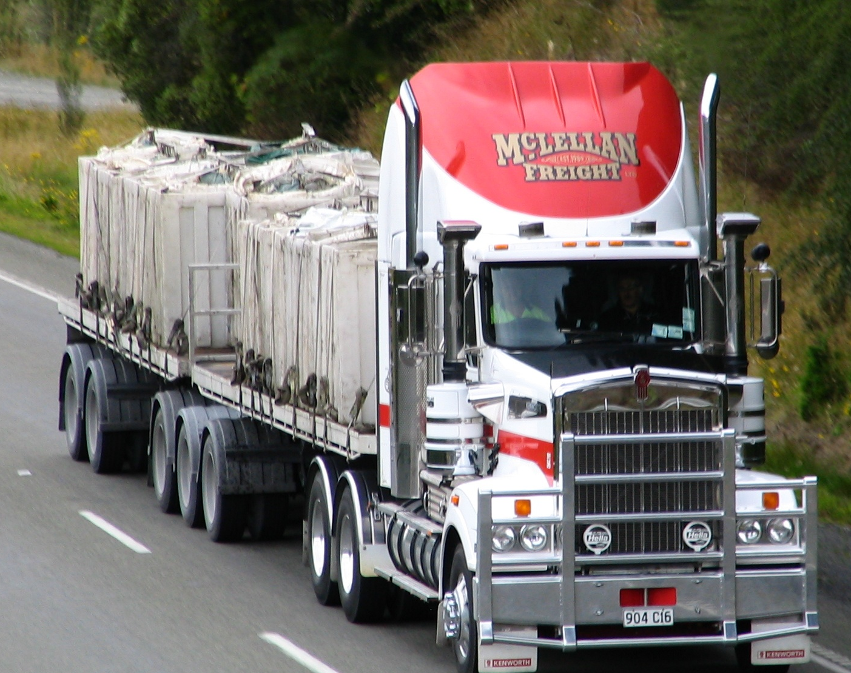
Forecasting Transportation Services Index (TSI)
` Lohit Marla

Slide 2
Objective: Develop a forecasting model for the Transportation Services Index (TSI) based on historical data excluding the external shocks.
TSI Definition: TSI is a measure of the volume of freight and passenger transportation services moved monthly by the for-hire transportation sector in the United States.
Components: TSI consists of three components: freight index, passenger index, and combined index, each incorporating data from various transportation modes.
Focus: Forecast TSI values exclusively, disregarding other index components, to reflect changes in demand for transportation services indicative of broader economic trends.
Methodology: Utilize time series analysis techniques to model historical TSI data and generate forecasts. Explore methods such as ARIMA and exponential smoothing.

Slide 3
Insights: Forecasted TSI values provide insights for stakeholders in the transportation industry, policymakers, and economic analysts.
Applications: Anticipate changes in transportation demand to inform decisions on infrastructure investments, capacity planning, and economic policy formulation.
Benefits: Improve supply chain management strategies, optimize logistics operations, and support decision-making processes in both public and private sectors.
Contribution: Contribute to understanding transportation services demand dynamics and provide actionable forecasts for informed decision-making.

Slide 4
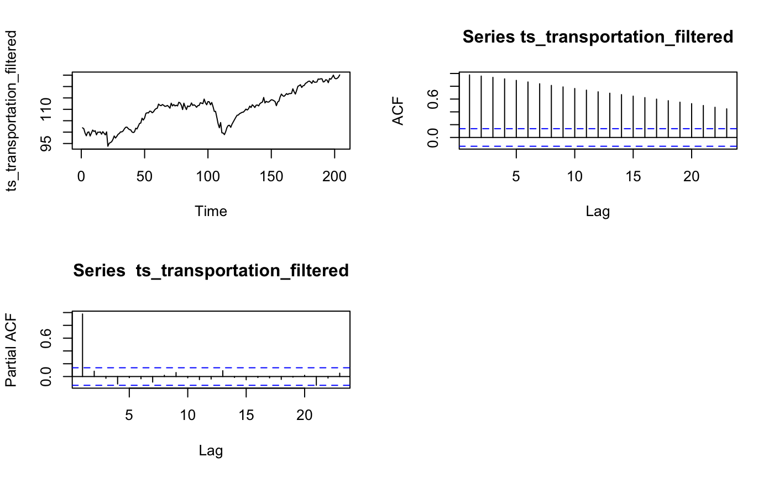
TSI Data

Slide 5
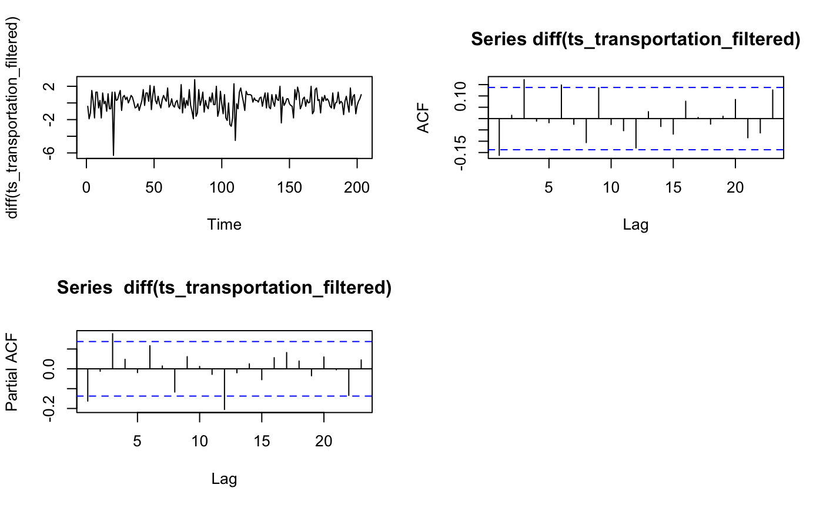
TSI Data – Difference

Slide 6
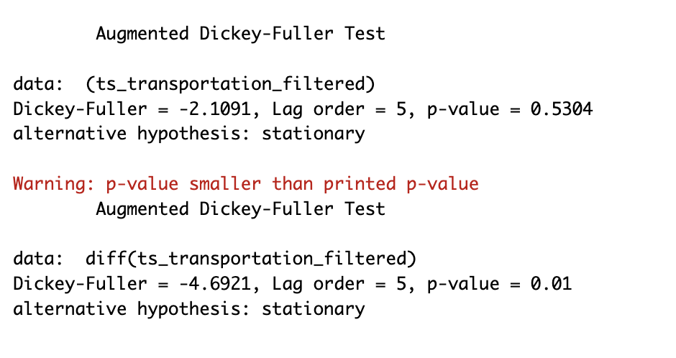
Stationarity Verification

Slide 7
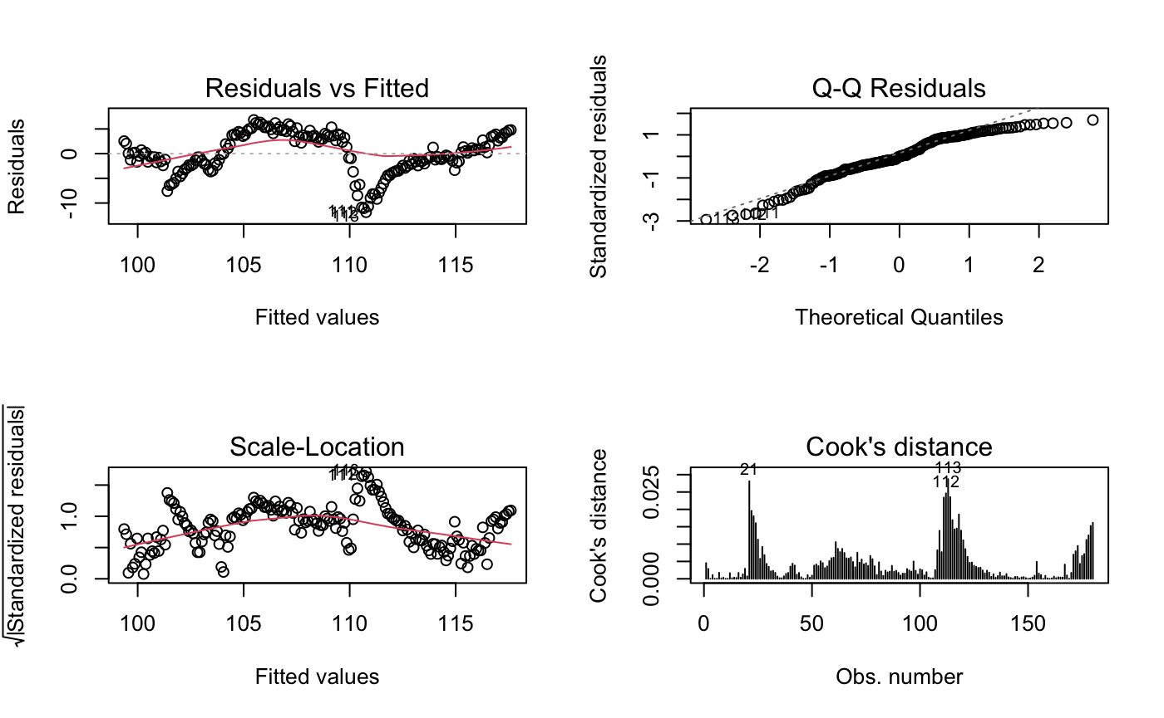
Simple Linear Model

Slide 8

Quadratic Linear Model

Slide 9
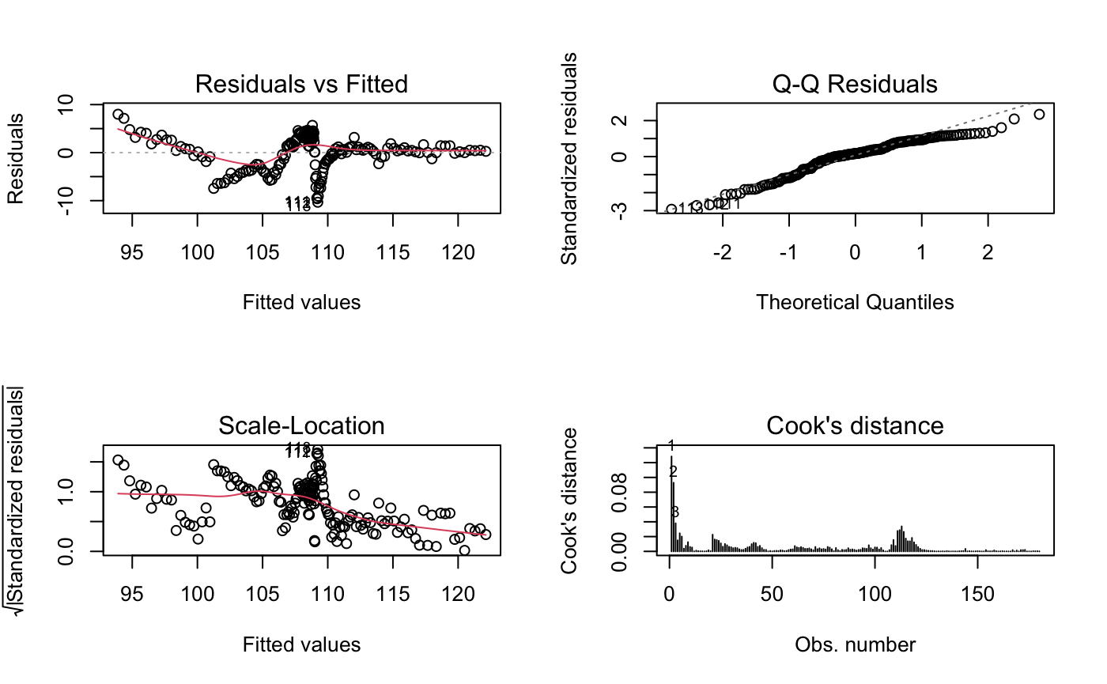
Cubic Linear Model

Slide 10
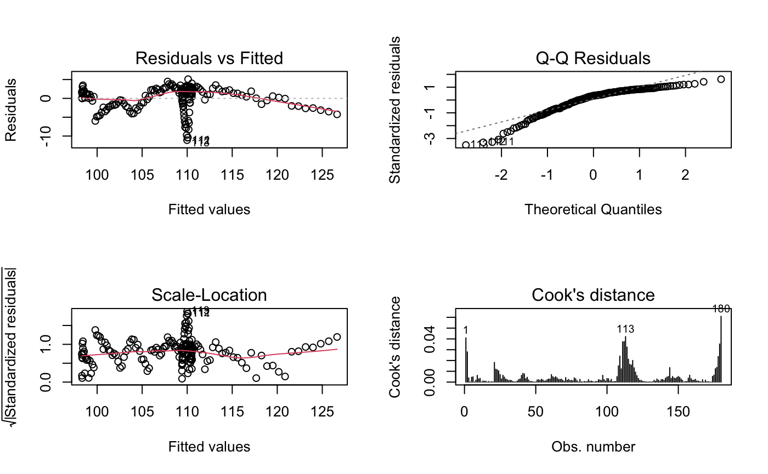
Bi–Quadratic Polynomial

Slide 11
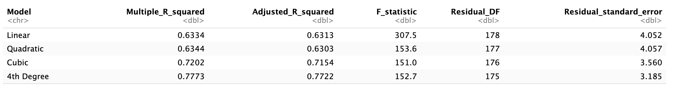
Models Summaries

Slide 12
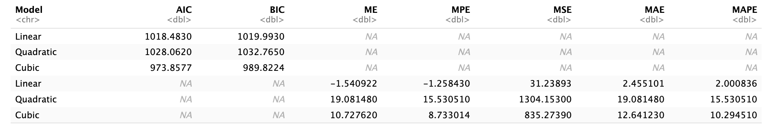
In-Out Sample Accuracies

Slide 13
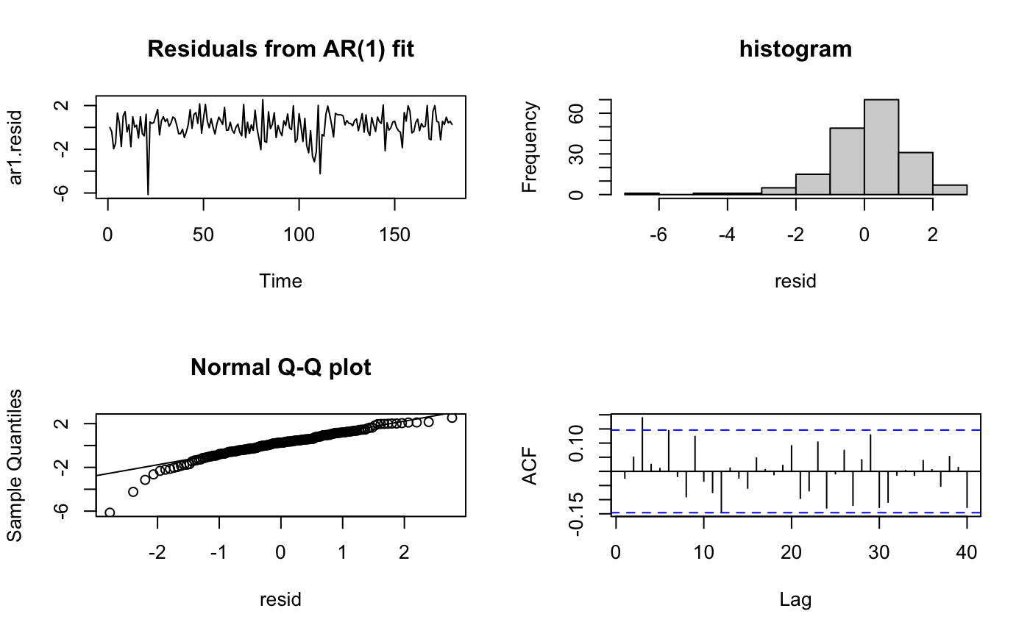
0,1,1 – Residual Plot

Slide 14
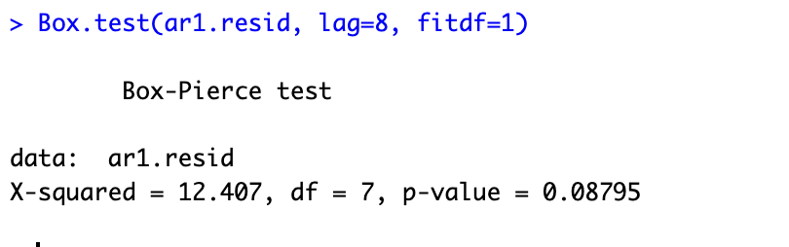
0,1,1 Box-Pierce Test
There is an auto correlations between the data

Slide 15
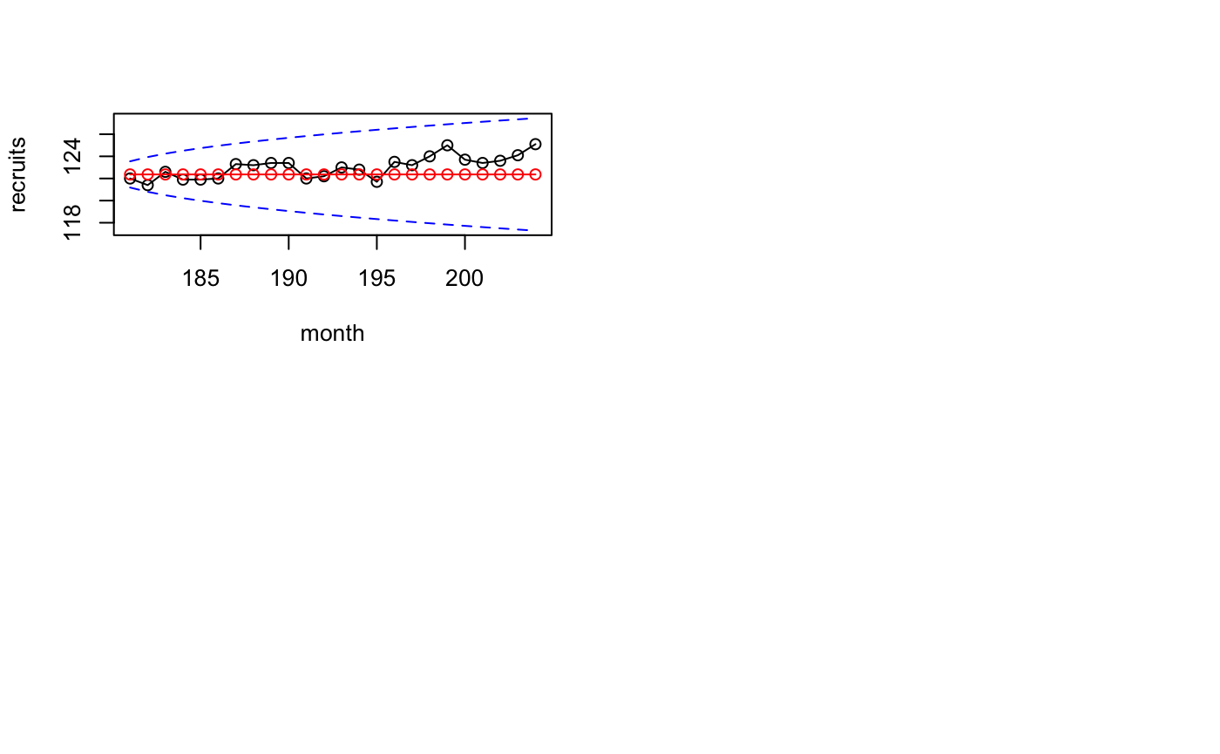
0,1,1 - Forecast

Slide 16
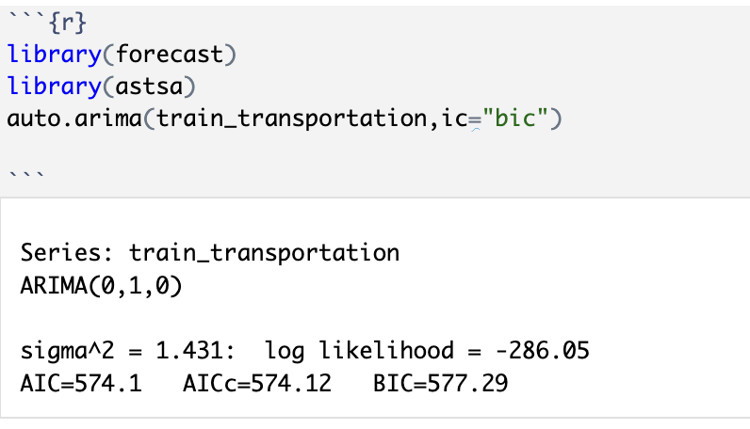
Automatic Order Identification

Slide 17
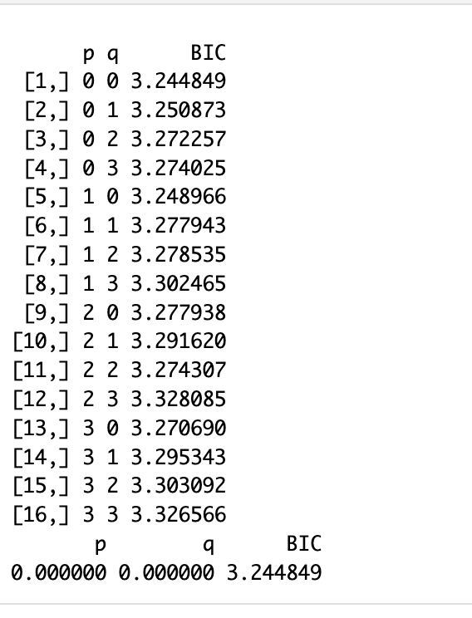
Iterative Method

Slide 18

0,1,0 – Residual Plot

Slide 19
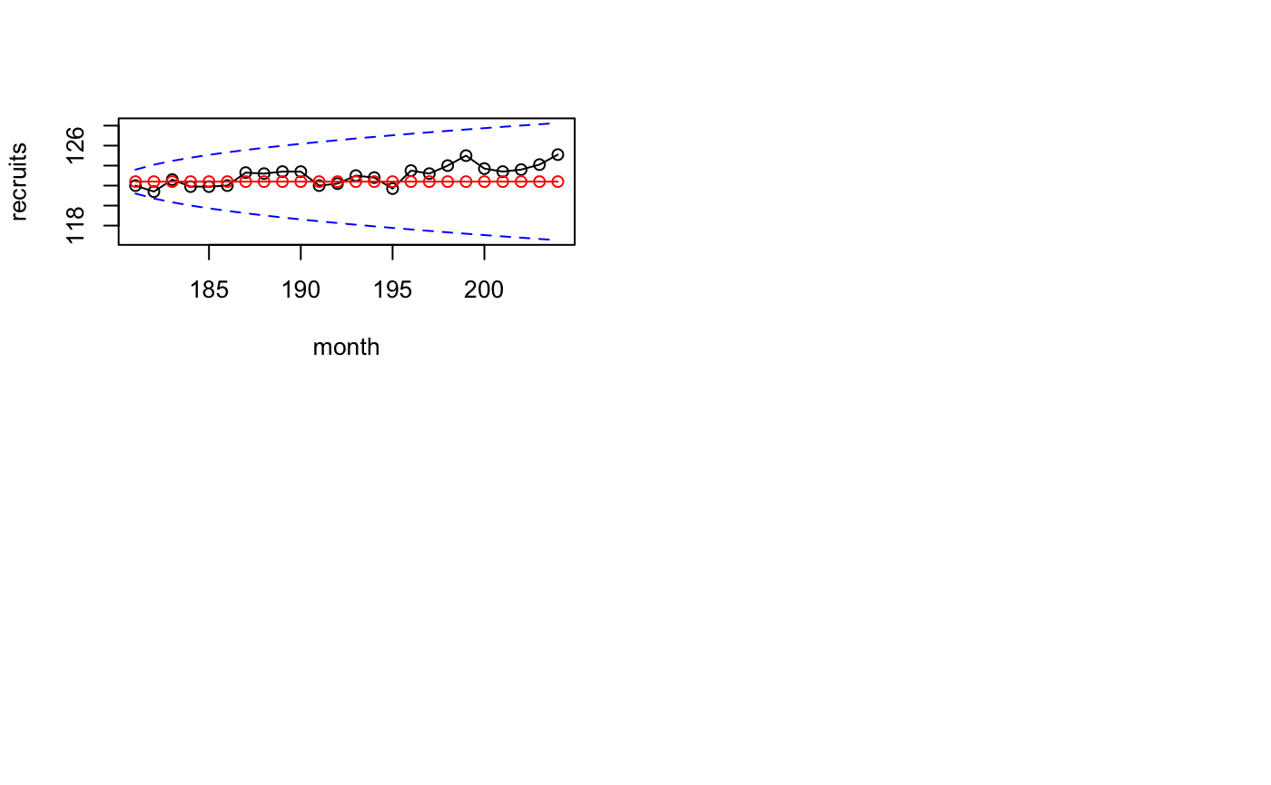
0,1,0 - Forecast

Slide 20
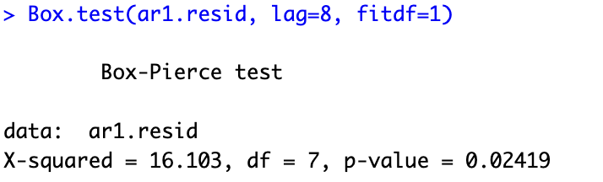
0,1,0 Box-Pierce Test
There are no auto correlations between the data

Slide 21
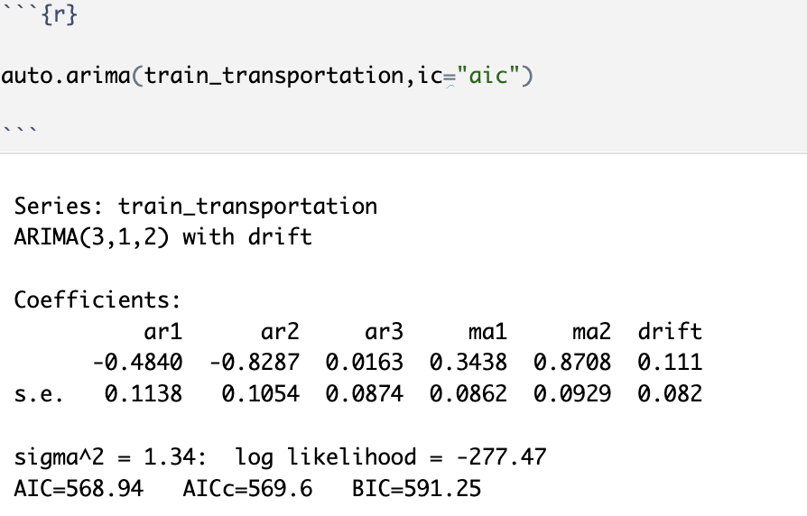

Slide 22
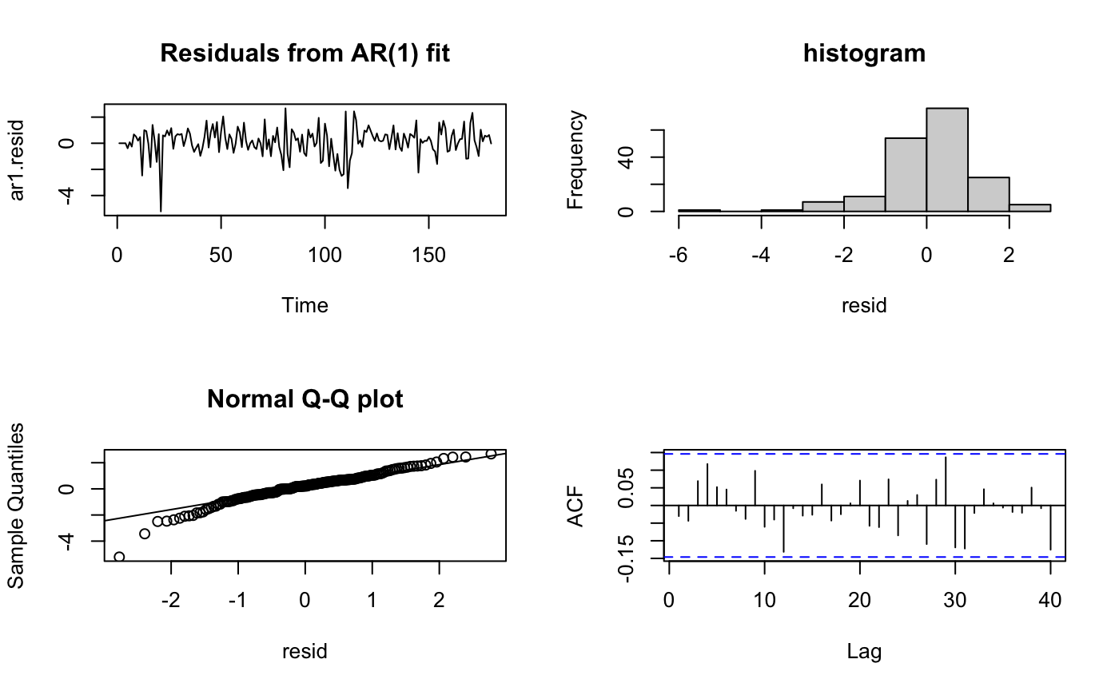
3,1,2 – Residual Plot

Slide 23

3,1,2 - Forecast

Slide 24
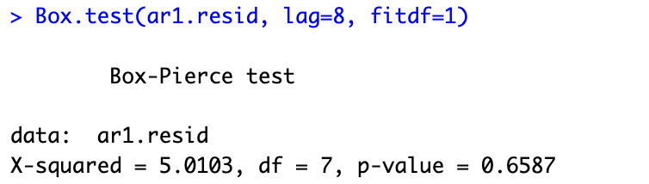
3,1,2 Box-Pierce Test
There is an auto correlations between the data

Slide 25
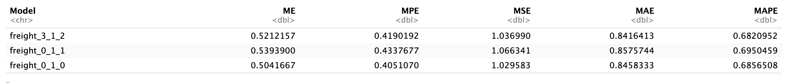
ARMA - Accuracies

Slide 26

Thank You

